Slide 1
Long-Term Trends in Mammalian Sperm Abnormality
Nozomu Hirama

Slide 2
Decline of Reproductive Health
-There could be a general decline in reproductive ability across mammalian species
-Severe consequences that are usually overlooked
-Conservation applications with more effective protective strategies.

Slide 3
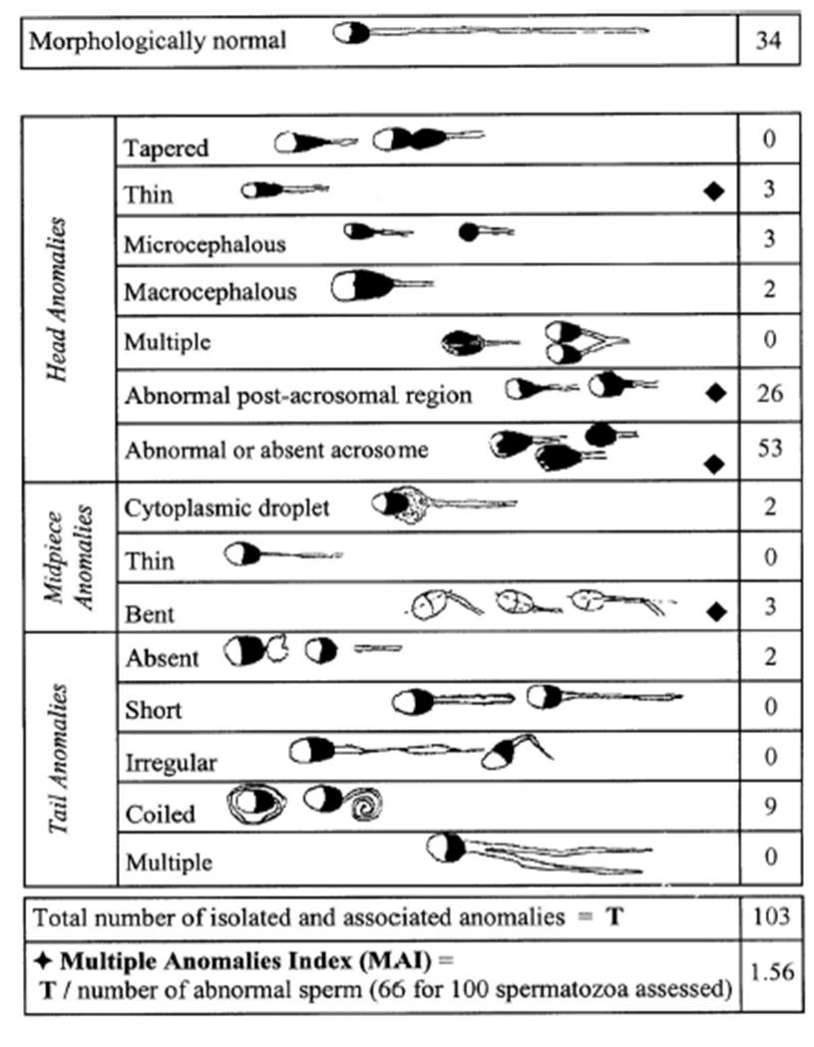
Sperm Quality and Assessment
- Many potential indicators of reproductive quality.
- Morphologically abnormal sperm count/proportions is common
Abdelhamid, Mohamed & Bujan, Louis & Hamdi, Safouane. (2019). Effects of exogenous factors on male gametes and genomes: potential consequences of mild temperature increase in testis and epididymis on the quality of the gamete.

Slide 4
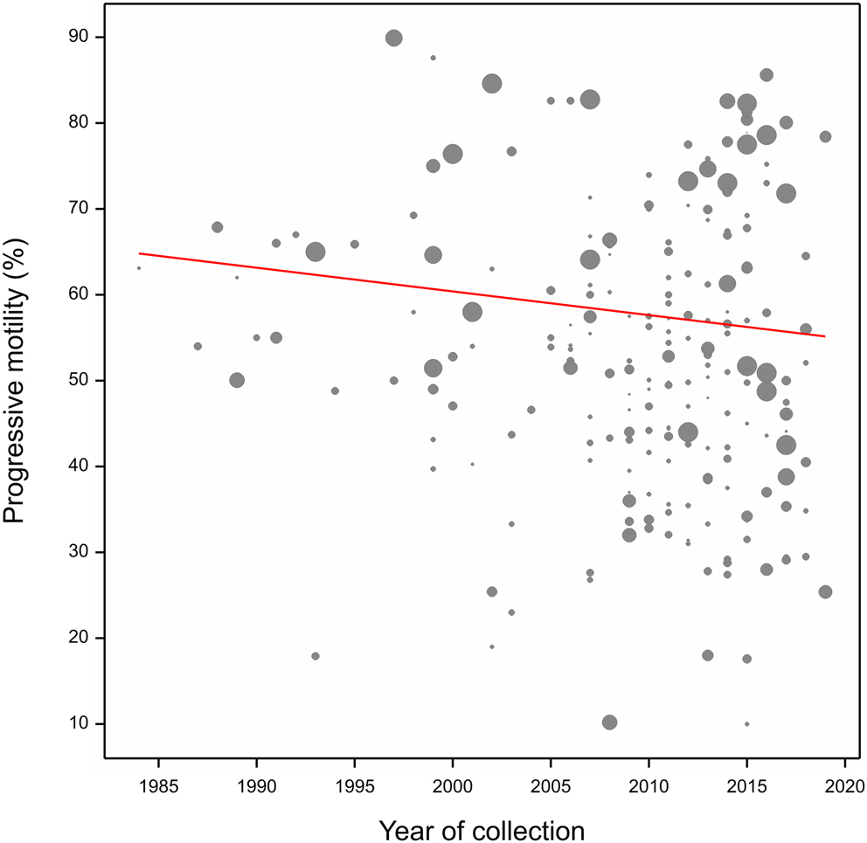
Temporal Declines in Equine Sperm Motility
n=230 data points of horse sperm motility
Harris IT, Maddock C, Farnworth M, Nankervis K, Perrett J, Pyatt AZ, Blanchard RN. Temporal trends in equine sperm progressive motility: a systematic review and meta-regression

Slide 5
Research Goals
Collect
- Collect data on a wide range of characteristic measures of sperm quality, representing a greater number of taxonomic groups.
Assess
- Assess whether there is a correlation between certain sperm quality-traits and time (i.e. the year the sample was collected).
Identify
-Identify certain groups of animals that may be more targeted by these changes in sperm quality over time, as well as those that may be less vulnerable.
Project
-Project trends into the future for conservation-related discussions.

Slide 6
Lit-Review Process - Variable Decision
Main responses
Normal/abnormal proportions
Motility
Main predictors
Species/taxon
Wild/Captive
Pairing in captivity

Slide 7
Lit-Review Process – Data Sampling
Two potential approaches to data sampling
Species-biased approach
Take random sample from the first N papers found with sperm-quality related search-terms
More information per species
More focus on potentially threatened species
Species-inclusive approach
Take random sample from the first N papers found with sperm-quality related search-terms
Less bias in sampling
Able to identify distribution and availability of sperm-quality data across species.

Slide 8
Analysis Approach – Data Distribution
Explore geographic biases in reproductive data availability
Map data abundance on global scale
Explore taxonomic biases in reproductive data availability
Map data abundance on phylogenetic tree
Caution with this approach depending on lit-review approach
Explore data availability of different sperm quality measures
Consensus of collection methods
Availability of temporal data

Slide 9
Analysis Approach
GLME will be fit to model
Random intercepts
Random slopes
Challenges
Temporal data availability/accuracy
Fitting model to rare species
Irregular sampling times

Slide 10
Plots! (At least what I have)

Slide 13
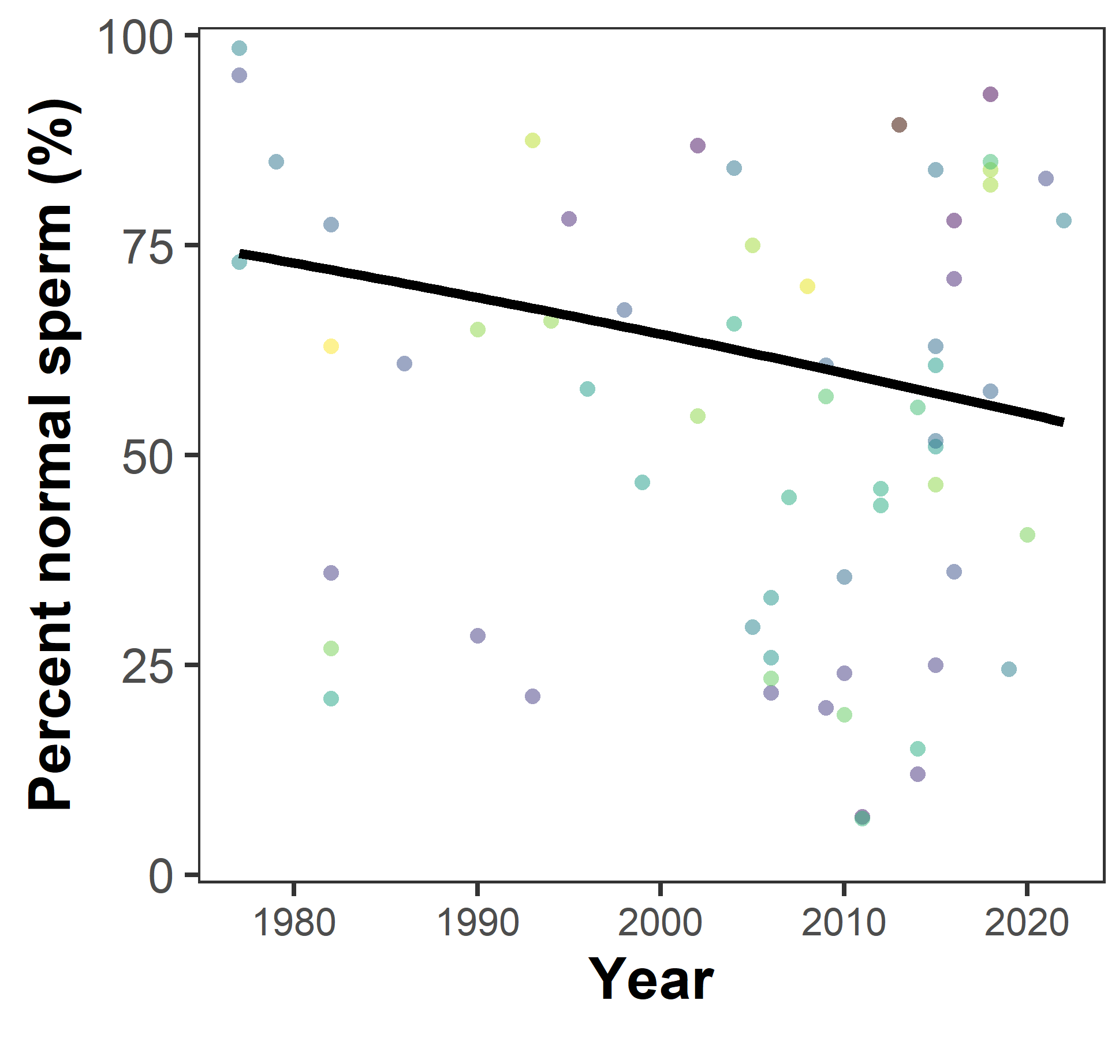
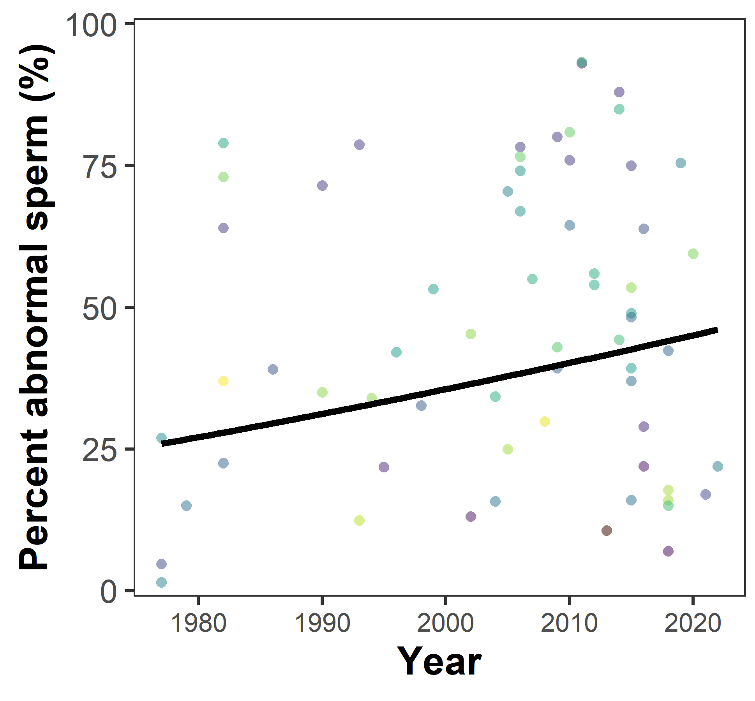

Slide 14
What now?
Continue lit-review
Aiming for ~1000
Systematically report and record lit-review process using PRISMA

Slide 15
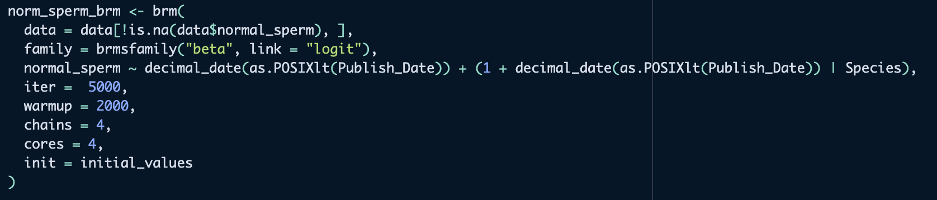
What now?
Fix/Improve models
Potentially the need for expanding the dataset first.
Account for phylogenetic autocorrelation if doing overall analysis
Calculate effect sizes
Add predictors
Potentially the need for expanding the dataset first
Use models for predictions

